Slide 1
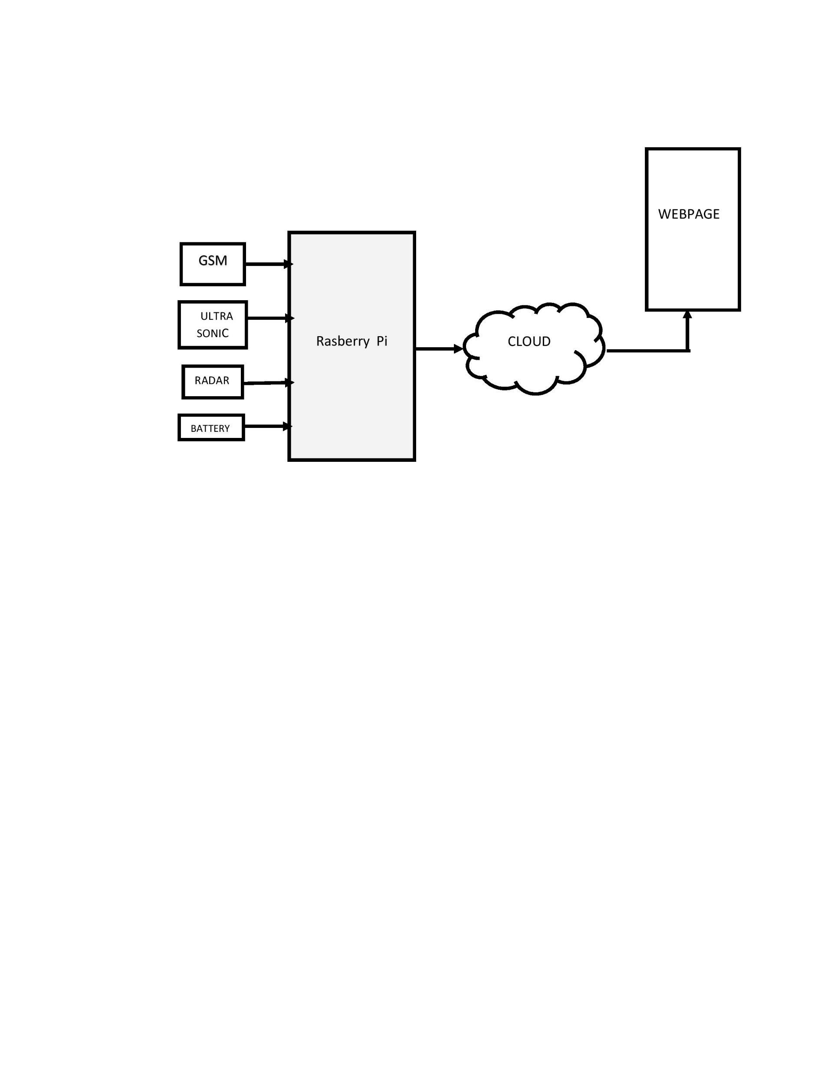
PUBLIC TRANSPORTATION OPTIMIZATION
The project will provide a valuable service to both public transportation administrators and riders. It can lead to more efficient and user-friendly transportation systems while also offering opportunities for data analysis and optimization.

Slide 2
COMPONENTS
HARDWARE
Raspberry Pi board (e.g., Raspberry Pi 3 or 4).
GPS module (e.g., NEO-6M GPS module).
-Mobile data modem (optional for internet connectivity).
Power source for Raspberry Pi.
Vehicle with Raspberry Pi mounted.
SOFTWARE
Python
Database system
Location tracking libraries
Web frameworks and libraries
Data analysis libraries
Machine learning
Security and privacy tools

Slide 3
PYTHON PROGRAM
packet = gpsd.get_current()
if packet.mode >= 2: # Check if GPS has a fix
latitude = packet.lat
longitude = packet.lon
rider_name = input("Enter rider's name: ")
# Insert rider's data into the database
db_cursor.execute("INSERT INTO riders (name, location) VALUES (?, ?)", (rider_name, f"{latitude}, {longitude}"))
db_connection.commit()
print(f"Location: {latitude}, {longitude} saved for {rider_name}")
except Exception as e:
print(f"Error: {e}")
# Close the database connection when done
db_connection.close()
import gpsd
# Connect to the SQLite database
db_connection = sqlite3.connect('riders.db')
db_cursor = db_connection.cursor()
# Create a table for rider data
db_cursor.execute('''
CREATE TABLE IF NOT EXISTS riders (
id INTEGER PRIMARY KEY,
name TEXT,
location TEXT,
timestamp DATETIME DEFAULT CURRENT_TIMESTAMP
)
''')
db_connection.commit()
while True:
try:

Slide 4
WORKING MODULE
1. Location Tracking:
- Utilize GPS or other location tracking technologies to collect real-time data on the buses or vehicles in your public transportation system.
- Consider using libraries like `geopy` or `GPSD` in Python to gather location data.
2. Rider Database:
- Create a database to store information about riders, including their boarding and alighting locations, timestamps, and unique identifiers.
- You can use a relational database like SQLite or MySQL, or a NoSQL database like MongoDB.
3. Data Collection:
- Develop a data collection system to record when and where riders board and alight from vehicles. You can use sensors or mobile applications for this purpose.
- Integrate the data collected with the rider database.
4. Route Optimization:
- Use the location data to optimize bus or vehicle routes. Consider implementing algorithms like Dijkstra's or A* for route planning.
- Take into account traffic conditions and real-time location updates to make dynamic adjustments.
5. Real-time Updates:
- Create a system to provide real-time updates to riders about the estimated time of arrival (ETA) and any delays.

Slide 5
6. Web Interface:
- Build a web application that allows riders to access information about bus routes, ETAs, and delays.
- Implement a dashboard for administrators to manage and visualize the collected data.
7. Data Analysis:
- Analyze the collected data to identify patterns and make data-driven decisions for route optimizations.
- Python libraries like Pandas and Matplotlib can help with data analysis and visualization.
8. Machine Learning (Optional):
- Implement machine learning models to predict future ridership and optimize routes based on historical data.
9. Security and Privacy:
- Implement security measures to protect rider data and ensure privacy compliance.
10. Documentation and User Manuals:
- Provide clear documentation and user manuals for both administrators and riders on how to use the system.
NAME: THARANI S
REG NO: 610821106314

